Slide 1
Welcome
Name : Bin Chhunnay
Event : Monthly Meeting
Career : Student, PEPY and USEA
Date : 27th August 2017

Slide 2
The art of living
What is the art of living ?

Slide 3
Yoga and Meditation

Slide 4
2. Mastering the mind

Slide 5
3. Social orientation
Family

Slide 6
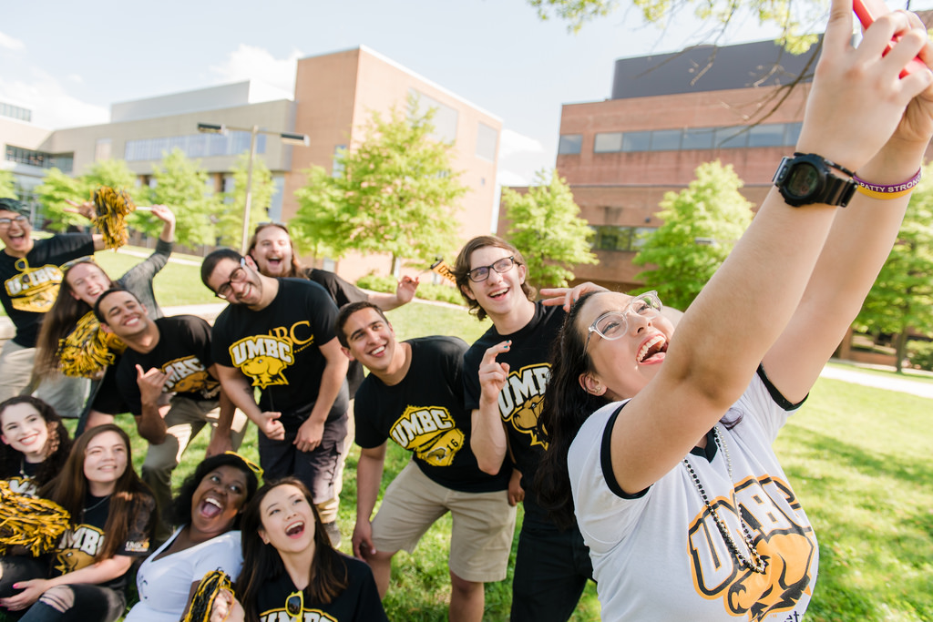
Relationship

Slide 7
Thank you for your attendance
Q & A

