Slide 1
Name : Bin Chhunnay
School : University of South-East Asia and PEPY
Date : 15th August 2017

Slide 2
Purpose of Lesson
Know about pros and cons of Facebook
How to use Facebook good
Question
Facebook is a social networking site that makes it easy for you to connect and share with your family and friends online
2. Mark E.Zuckerberg
3. February 2004.
What is Facebook ?
Who is made Facebook ?
When Facebook grow up ?

Slide 3
Pros of Facebook
keep in our communication or contact
Keep in touch :

Slide 4
Make us to happy

Slide 5
Share with Other : Share about something that happen in our life to each other like married, group of photos or an announcement.

Slide 6
Keep a Journal : it can use for own benefit as well as the benefit of other because we can look back to our update or something that we do on years gone

Slide 7
In studying : get more new lessons, do homework or know about information of education

Slide 8
For business : we can announce about hotel, or restaurant and we can sale something in online like cloths or shoe, act.

Slide 9
2. Cons of facebook

Slide 10
Time-wasting : when we want to know more things like photos or videos, so we always scroll up and down until see something we want

Slide 11
Need to pay more to reach more : pay a lot of money on Facebook

Slide 12
Make an accident : when we use it not be careful somebody can threat you.

Slide 13
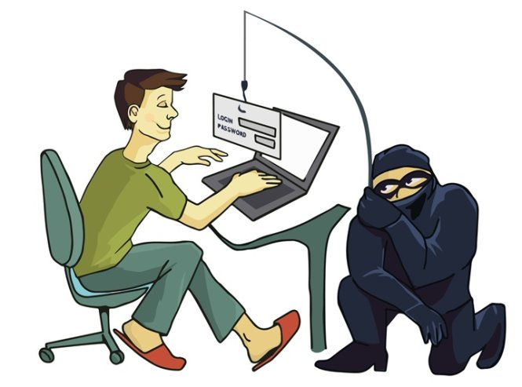
Fake page : Some fake Facebook accounts are hackers who are trying to steal our personal information or manipulate you to their benefit.

Slide 14
Future regret : Many adults have lost their job due to posts they made on Facebook

Slide 15
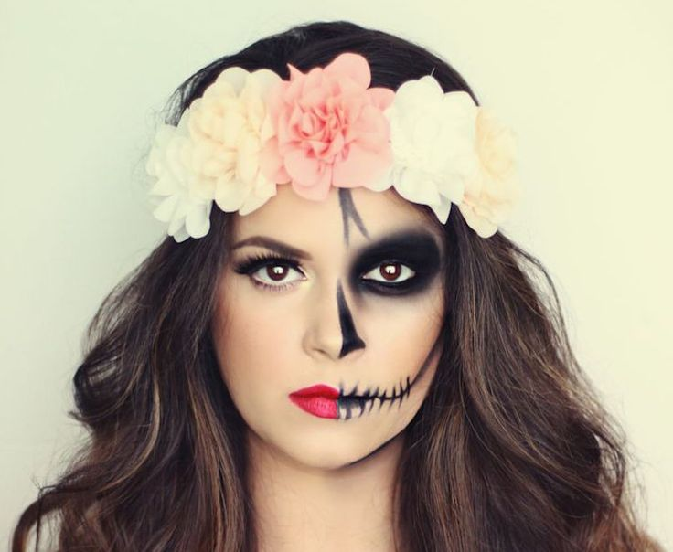
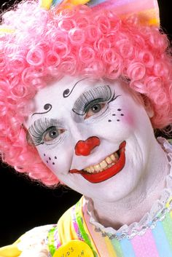
Image Issues : when a picture is uploaded to Facebook, it is public for the world to see, so somebody can be downloaded and misused.

Slide 16
Thank you for your attendance
Q & A

