Slide 1
THINKING
Positive Thinking
Negative Thinking
Purpose
Know about how to think positive
Stop to thinking to negative
Advantage of thinking
Disadvantage of negative thinking

Slide 2
Positive Thinking
Key 7 to think positive
Seek the valuable lesson in every setback

Slide 3
2. Responsible to our activities

Slide 4
3. Read Positive Quotes
4. Being Happy

Slide 5
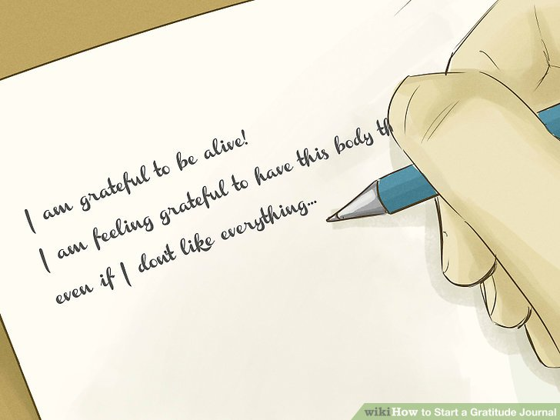
5. Keep a gratitude Journal.
6. Use positive words
to describe your life

Slide 6
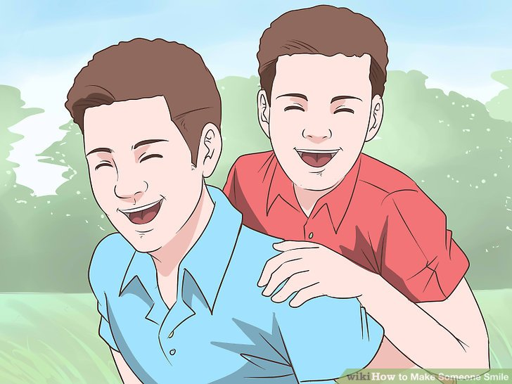
7. Make someone to smile
Advantage of Positive thinking
Positive mind attracts positive events
Great and harmonious relationships
Key of success
No more stress
You will notice the abundance of good things in your life
Boost of motivation
Beauty will shine from within

Slide 7
II. Negative Thinking

Slide 8
A perfect Person
2. Stressful

Slide 9
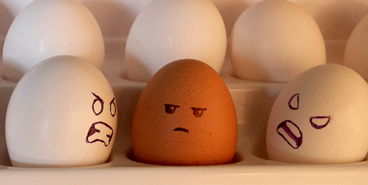
3. Fair and unfair
4. Hate

Slide 10
5. I’m cannot do everything
Disadvantage of negative thinking
No communication
Feeling Sorry in next time
Cannot success
Make you stressful

Slide 11
THANK YOU
Q & A

